Slide 1
Fine Motor Skills by Trisha Morris OTR & Dawn Pabst OTAS

Slide 2
School-Based Occupational Therapy
School-based occupational therapy is designed to enhance the
student‘s ability to fully access and be successful in the learning environment.(AOTA.org)
Areas that occupational therapists address in a school-setting:
Sitting Posture
Self-Care
Oral-Motor and Feeding
Play
Organization
Fine Motor Skills and Handwriting
Visual Perceptual and Visual-Motor Skills
Sensory Processing
Occupational therapists use occupation or “meaningful and purposeful activity” to improve skills. In a school setting occupation includes play, self-care, projects, and school work.

Slide 3
Fine Motor Skills
Fine motor skills are used for tasks such as:
Coloring
Cutting
Pasting
Handwriting
Typing
Buttoning
Zipping
Snapping
Tying shoes
Opening packages

Slide 4
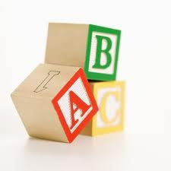
Building Blocks of Fine Motor Skills
Sensory Processing
Core Stability
Shoulder Stability
Bilateral Coordination
Eye-hand Coordination
Wrist Stability
Palmar Arches
Skill Side of Hand

Slide 5
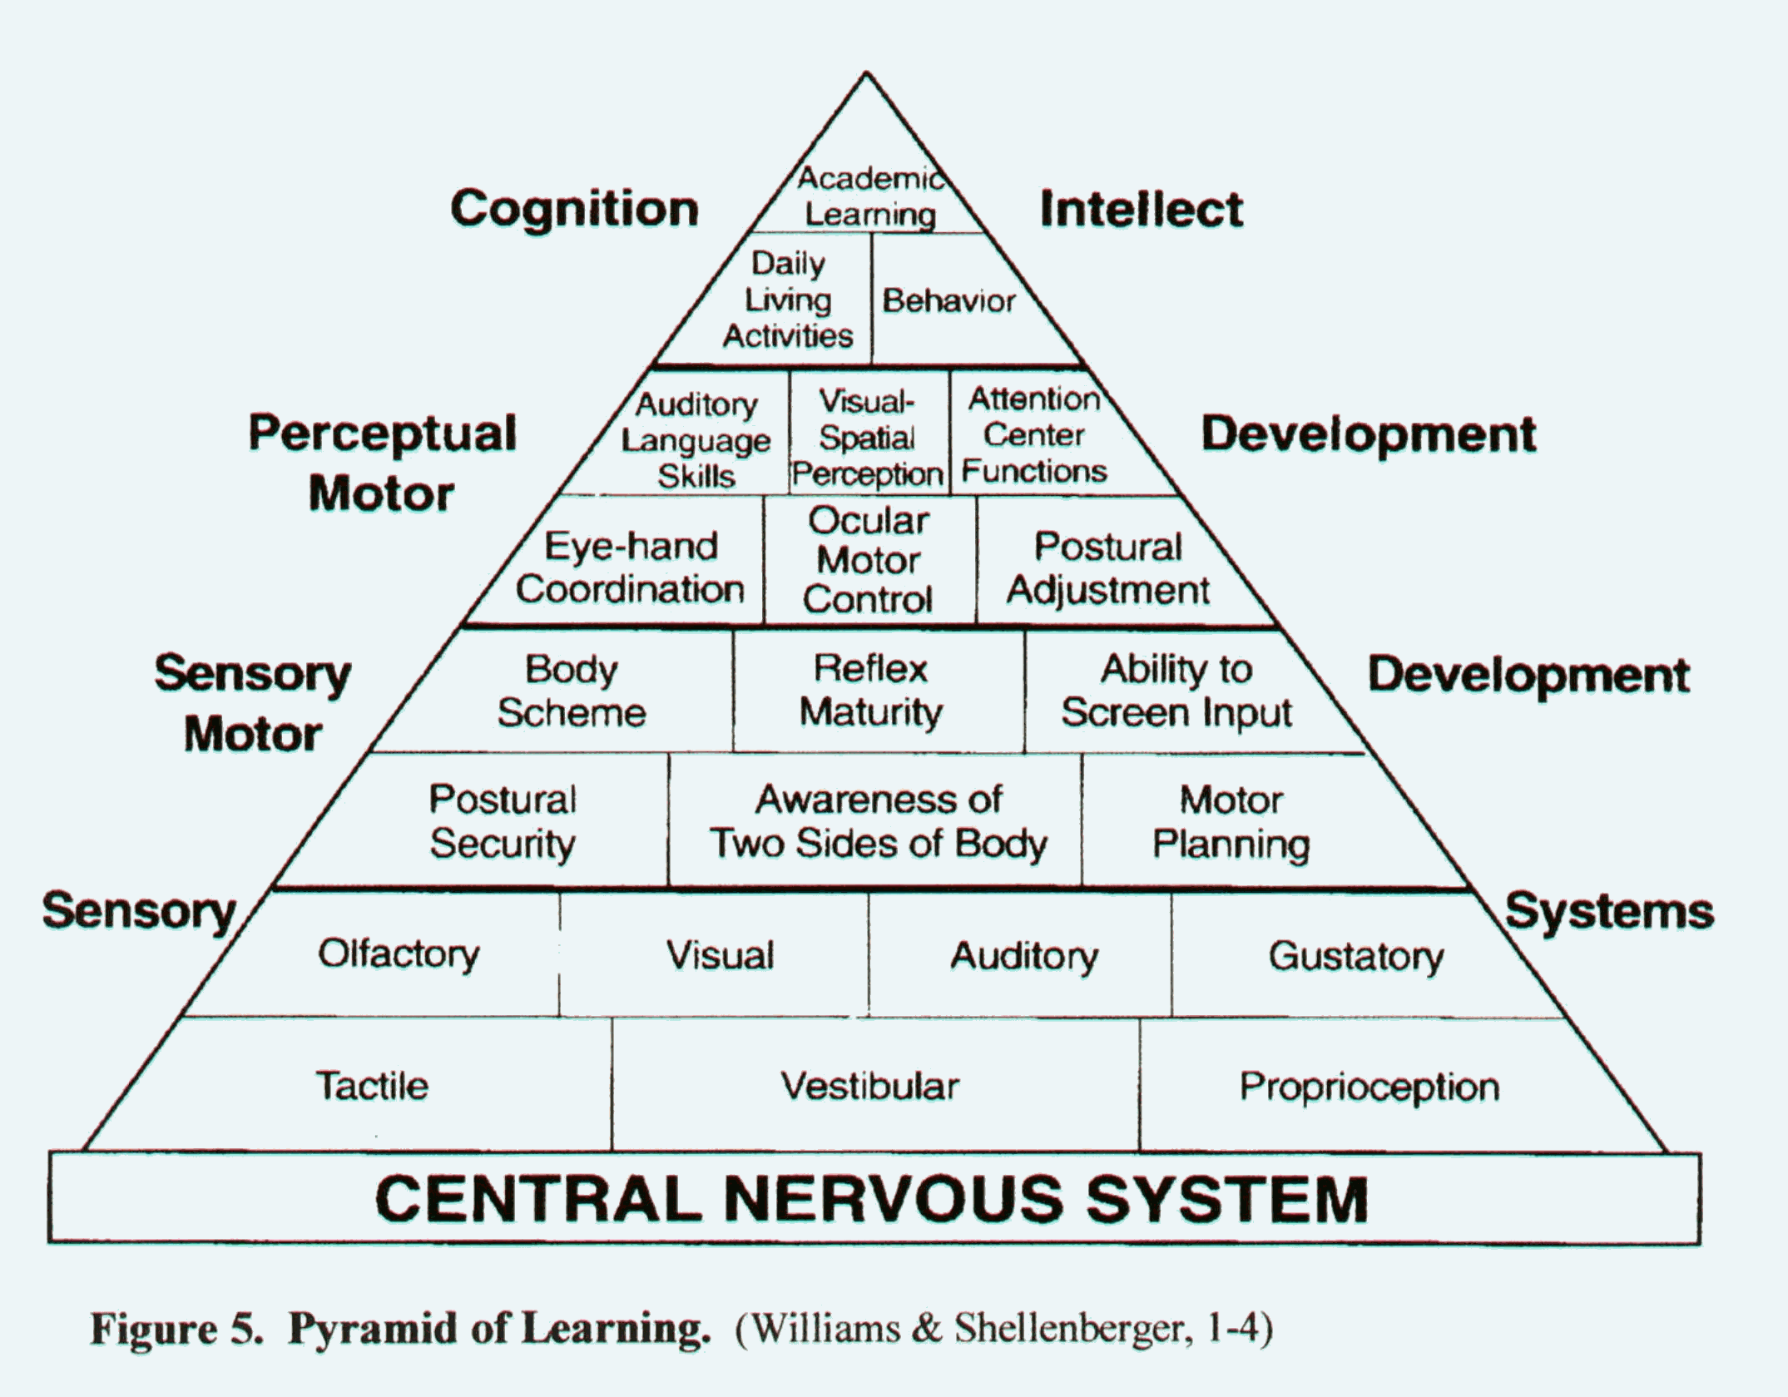
Sensory Processing
Dr. Jean Ayers, an occupational therapist and educational psychologist developed the Sensory Integration Theory. The pyramid below demonstrates her belief that the tactile, proprioceptive, and vestibular sensory systems are the foundation for other development.

Slide 6
Tactile System
The receptors for the tactile system are in our
skin. The tactile system processes information
regarding touch, temperature, and pain.
Activities that provide tactile input:
Play in sand (wet or dry)
Play in dry materials such as beans, bird seed, rice, and pasta
Water play
Shaving Cream
Finger Paint

Slide 7
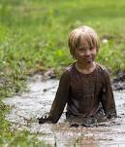
Activities that Provide Tactile Input
Play dough
Moon dough
Pop bubbles
Play with messy homemade recipes (see resources)
Roll cookie dough
Play in dirt/mud

Slide 8
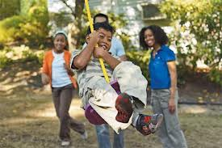
Vestibular System
The vestibular system processes information about movement and gravity. It helps us with spatial orientation and balance. Input is primarily received through the inner ear.
http://content.brainhighways.com/public/video

Slide 9
Activities that Provide Vestibular Input
Swinging
Swinging on a tire swing
Rocking in a rocking chair
Teeter totters
Bouncing on a large ball
Jumping on a trampoline
Hanging upside down on rings or trapeze
Bikes/Trikes/Scooters

Slide 10
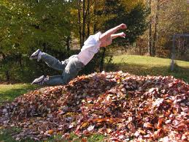
Proprioceptive System
The receptors for the proprioceptive system are in our muscles, ligaments, and joints. The proprioceptive system tells us where our body parts are and what they are doing.
http://content.brainhighways.com/public/video

Slide 11
Activities that Provide Proprioceptive Input
Jumping into a pile of pillows or pile of leaves
Jumping on a trampoline
Galloping
Skipping
Animal walks (bear walk, crab walk, wheel barrow)
Carrying objects such as small buckets of water or sand
Climbing on playground equipment
Monkey bars, trapeze, rings
Yoga poses

Slide 12
Core Stability
Core Strength is the strength in the abdominal and back muscles. This skill is required to complete fine motor tasks while sitting upright at a desk or table.
Activities to increase Core Strength:
Swing (pumping independently is the most beneficial)
Climb up and descend slides
Monkey Bars, rings, trapeze bars
Playground climbing equipment
Animal walks – bear walk, crab walk, log roll, wheelbarrow
Wall push-ups
Crawl
Lie on stomach to read books, color, and do puzzles

Slide 13
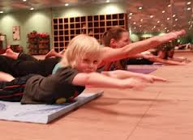
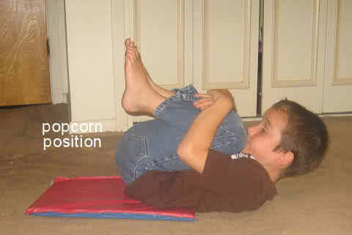
Activities to Increase Core Strength
Superman
Hold for 20 seconds
Popcorn
Hold for 20 seconds

Slide 14
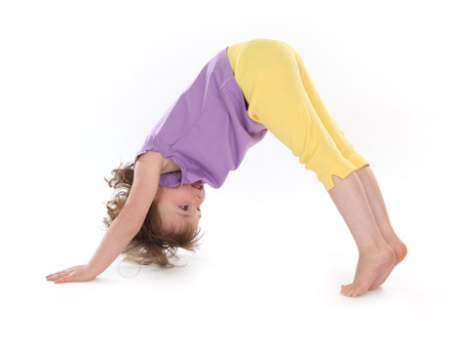
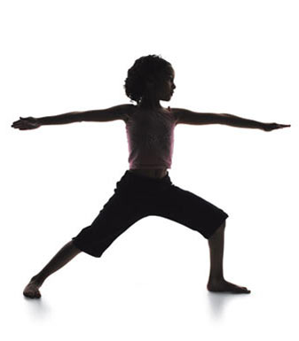
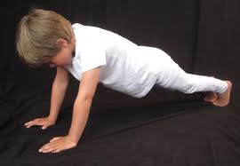
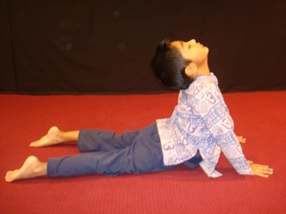
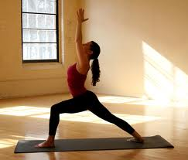
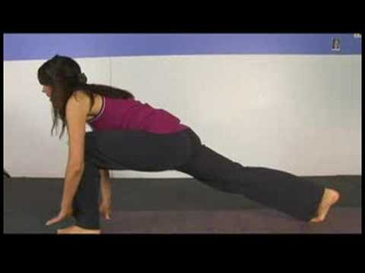
Activities to Increase Core Strength
Yoga poses

Slide 15
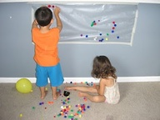
Shoulder Stability
Shoulder strength is needed in order to stabilize our
shoulder and keep it still to complete fine motor tasks.
Activities to help develop this skill:
Write on vertical surfaces such as chalkboard, white board, or easel
Playground climbing equipment
Monkey bars, rings, trapeze
Animal walks – crab, bear, or wheelbarrow
Yoga
Wall push-ups
Crawling

Slide 16
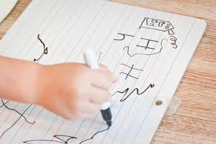
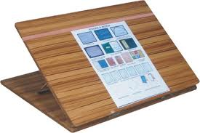
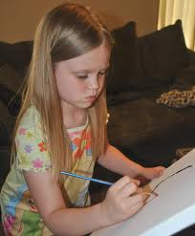
Shoulder Stability
Tabletop Easels help students, who are not able to stabilize their shoulder, to stabilize their elbow on the table. This puts their wrist into extension which promotes a proper pencil grasp.

Slide 17
Bilateral Coordination
Bilateral coordination is both sides of the body working together. Bilateral Coordination can be:
Both sides of the body doing the same thing (catching a ball or using a rolling pin).
Using alternating movements such as climbing up playground ladders.
Using each side of the body for a different action such cutting or stabilizing paper while writing.

Slide 18
Crossing Midline and Bilateral Coordination
The Left side of the brain controls the right
side of the body and vice versa. Being able to reach across the body demonstrates that both sides of the brain are working together. Crossing midline is necessary for bilateral coordination. As children mature, they naturally cross midline more frequently.
Lacking a hand preference can be a sign of not being able to cross midline. It can also be a sign of hand weakness.

Slide 19
Activities that Promote Crossing Midline
Sit cross legged
Hit a ball with a bat
Dance to music with streamers or scarves (Move the streamer back and forth in front of your body, make big circles, make a helicopter circle over your head)
Play Simon Says and reach across your body
Drive a car on a figure 8 race track without switching hands
Draw across a large piece of paper using one hand.

Slide 20
Activities that Promote Bilateral Coordination
Both sides doing
the same thing:
Rolling out play dough with a rolling pin
Catching a ball
Hit a ball with a bat
Throw a ball using a basketball toss
Zoom ball
Alternating
movements:
Crab walk, bear walk, wheel barrow walk, crawl through play tunnels
Climb up playground ladder or rock wall
Monkey bars
Ride a bike

Slide 21
Activities That Promote Bilateral Coordination
Each side of the body doing different things:
Juggle Scarves
Cut with scissors
String beads
Build with legos or construction toys
Cooking activities that involve both hands such as stabilizing a bowl while stirring, or stabilizing a piece of bread while spreading
with a knife

Slide 22
Eye-Hand Coordination
Eye-hand coordination or visual-motor integration is used for many daily activities at school including; handwriting, cutting, ball skills and copying tasks.
Activities to help develop this skill:
Play catch
Throw a ball, bean bag or balled up sock at a target
Hit a ball with bat. Hit the ball from a tee or hit a playground ball with a bat if this activity is too difficult.
Play tether ball
Play balloon volley

Slide 23
Eye-Hand Coordination
Pop bubbles
Play with blocks, legos, or other construction toys
Do crafts activities that involve stringing beads or lacing
Board games such as Jenga, Mr. Mouth, Operation, Don’t Break the Ice, Perfection, and Let’s Go Fishing
Cutting activities

Slide 24
Wrist Stability
The ability to stabilize the wrist so the fingers can move with power and control.
Activities to increase wrist stability:
Work on a vertical surface (Lite Brite, ink stamps, Colorforms, felt boards, white board, magnets, stickers)

Slide 25
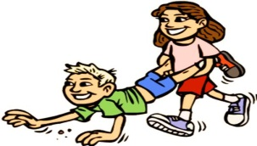
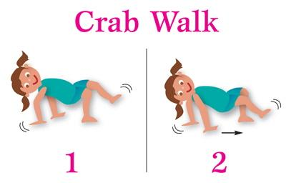
Activities to Increase Wrist Stability
Bear weight through hands (donkey kicks, wheelbarrow walk, crab walk, bear walk)

Slide 26
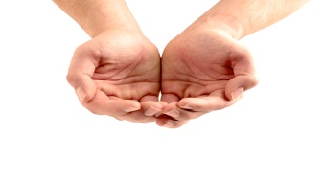
Palmar Arches
Palmar arches help us grasp objects and hold the hand in a position so our fingers can move with power and control.

Slide 27
Strengthening the Palmar Arches
Tear and crumple paper
Games that involve cupping hands to hold dice
See how much sand, beans, or rice you can pour into hands before it spills
Roll ball of play dough or cookie dough with both hands
Use cookie cutters to make cookies or shapes with play dough

Slide 28
Strengthening the Palmar Arches
Cut play dough with plastic knife
Use a play dough pizza cutter
Use plant sprayers to erase chalk boards, or spray watered down paint onto paper
Use tongs or large tweezers to pick up cotton balls or small toys
Place clothespins or use clothespins to pick up objects
Squeeze glue bottles and glitter paint to do crafts
Stress balls
Squeeze sponges

Slide 29
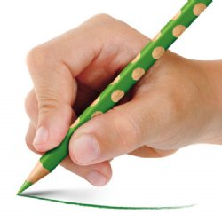
The Skill Side of the Hand
The thumb, index finger, and middle finger
make up the skill side of the hand.

Slide 30
Developing the Skill Side of the Hand
Turn over cards, coins, or buttons without bringing them to the edge of the table.
Place coins in piggy banks
Use eye-droppers or pipettes, mix food coloring and water to make pictures.
Use small pieces of chalk, crayons, or pencils to draw with
Roll play dough into small balls with thumb and index finger
Pinch play dough with thumb and index finger
Use stamps or vegetable/fruit stamps

Slide 31
Developing the Skill Side of the Hand
Wind up toys
Tongs
Bubble tongs
Clothes pins
Scissors
Twist caps
Peg boards
Lite brite
Draw in play dough with toothpicks
Water squirt toys
String beads

Slide 32
References
Kranowitz, Carol Stock. The Out-of-Sync Child: Recognizing and
Coping with Sensory Integration Dysfunction. New York, NY: The
Berkley Publishing Group, 1998.
Williams, Mary Sue and Sherry Shellenberger. "How Does Your
Engine Run?" A Leader's Guide to The Alert Program for Self-
Regulation. Albuquerque, NM: TherapyWorks, Inc., 1996.
Olden, Athena Ready Bodies, Learning Minds, A Key to Academic
Success, Second Edition. Copyright 2006.
Therapystreetforkids.com
Brainhighways.com
ot-mom-learning-activities.com/bilateralcoordination

Slide 33
References
Fc.stoughtonschools.org/pleblanc/otactivities.
pdf
School-ot.com/Fine%20motor/20101
Skillbuildersonline.com
Myteacherpages.com//webpages/schynoweth/
files/fmactivities.pdf
Prinary.woisd.net/index.php?option=com
K-12.pisd.edu/currinst/sped/ot/teachtips2.htm

Slide 34
Resources
Yoga CD: Dance for the Sun by Kira Willey
The Out of Sync Child by Carol Kranowitz
Recipes:
Shaving cream and cornstarch
Homemade moon dough: 8 parts flour to 1 part baby oil
Kool-Aid paint: Mix Kool-Aid and glue
Goop: Mix corn starch and water. You can add food coloring
Ice cube paint: Mix finger paint and water. Freeze.

Slide 35
Resources
Sidewalk chalk in plant sprayers: 1. Add cornstarch to one cup of hot water whisking to mix so that there are no clumps. Add one teaspoon of washable tempura paint and a squirt of dishwashing liquid. Mix well. Pour it into your squirt bottles and shake well.
Paint with shaving cream and glue mixed together to make puffy paint
tammysrecipes.com/homemade playdough (This website has recipes for homemade scented play dough)
Puffy Paint: 1 cup salt, 1 cup flour, 1 c water, food coloring. Put in old glue bottles or ketchup/mustard bottles.

Slide 36
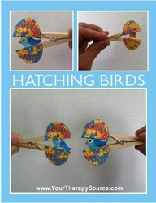

Slide 37
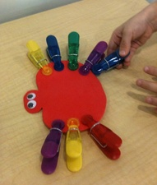

Slide 38
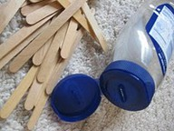

Slide 39
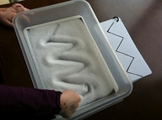

Slide 40
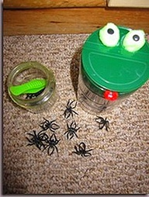

Slide 41
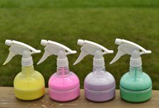

Slide 42
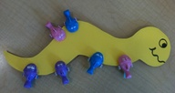

Slide 43
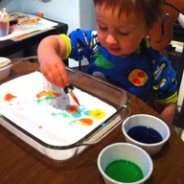

Slide 44
